Slide 1
Interview Practice and Structure
Carol Bartlett, MSc. (SHE/HER)
Jan 15, 2026
Notes:
Hi, everyone welcome to week two of the Lab2Market core program
Time is really flying by. It’s hard to believe we’re already into the second week
Hopefully you had a good week of getting out of the building, and engaging with potential customers and stakeholders
I imagine you are starting to gain some insights into your target customers and their problems
and validating your value proposition.
We have been talking a lot about customers and value propositions in the pre-program and core program to date, because it truly is the must fundamental building block of a successful business
But this week and for the remainder of the core program, we will start delving a little bit deeper into the other aspects of our business model
This week in particular, we will discuss customer relationships, and channels.

Slide 2
GETTING TO THE WHY
KEY CHARACTERISTICS
AGENDA
INTERVIEW STRUCTURE
WHAT CAN YOU LEARN IN AN INTERVIEW
PRACTICE: IT IS A SKILL TO DEVELOP
Notes:
Our agenda today deals with the following topics
[Read agenda topics]

Slide 3
Interviews:
Getting the story behind the story.

Slide 4
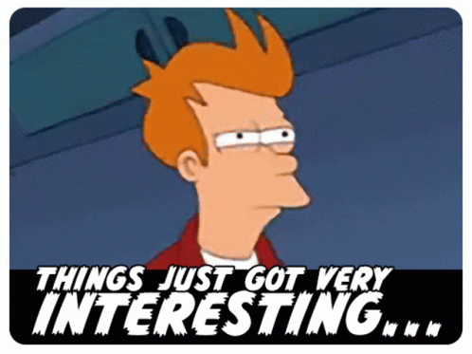
Getting a pass “This is interesting.”

Slide 5
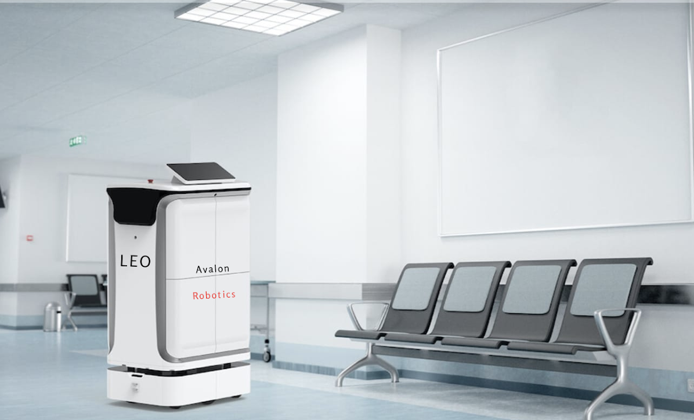
Robots in Hospitals
Currently, a person delivers drugs from the pharmacy to each floor.
Hypothesis: A robot could deliver drugs securely to each floor.

Slide 6
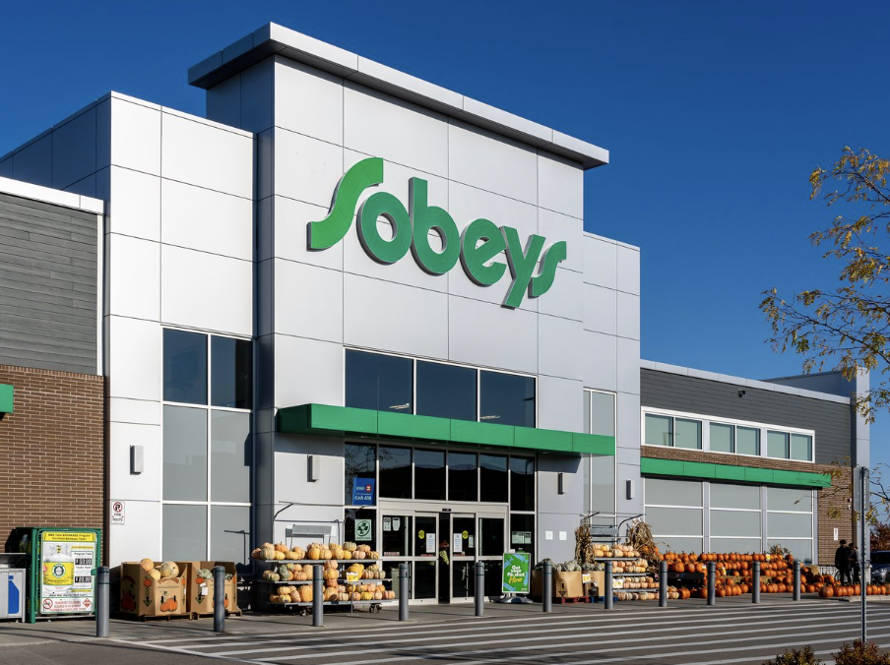
Trucking of Groceries
Most produce comes to Newfoundland island via the ferry, the ferry doesn’t run in bad weather.
Hypothesis: Shipping groceries with us would secure timely deliver in bad weather times.

Slide 7

A gift experience

Slide 8

The WHY
The purpose of the interviews in customer discovery is to see the connections.
Cause and Effect

Slide 9
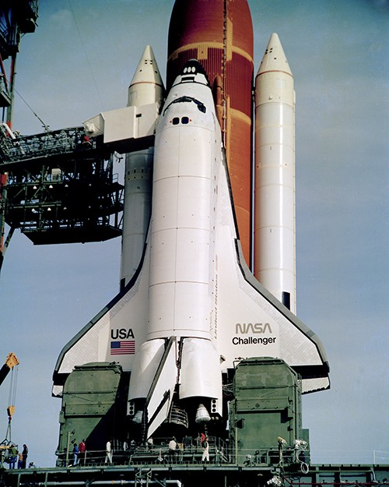
A cautionary tale of why
Getting to the bottom of something.

Slide 10

Key Characteristics
In-depth and Open-ended
Contextual Understanding
Combines Interviews with Observation
Focuses on the "Why" Behind Actions

Slide 11
Example Interaction:
Interviewer: "Why did you decide to start using a meal kit delivery service?"
Customer: "I wanted to save time during the week."
Interviewer: "Why was saving time important to you?"
Customer: "I was spending too much time planning meals and grocery shopping."
Interviewer: "Why was that a problem for you?"
Customer: "I felt like I didn’t have enough time for other important things, like work and family."
Interviewer: "Why is it important to have more time for work and family?"
Customer: "I value being productive at work and want to spend more quality time with my kids."
Interviewer: "Why do you feel the meal kit service helps with that?"
Customer: "It makes me feel organized and less stressed, which improves my focus and my mood."
The Power of Why
This topic is accessible, allows for diverse responses, and creates opportunities to uncover deeper motivations like time management, stress reduction, and family priorities.

Slide 12

Groups
Why did you decide to study at your university?
Switch roles
Why did you decide to join this club or L2M?

Slide 13

Part 1:
The Welcome
Spend 2-3 minutes on ‘why’
Why this interview?
and what is it about?

Slide 14
PART 1: The Welcome
“Thank you for taking the time to speak with me today. I want to hear your thoughts on a few things relating to the oceans industry because I’m working on a project and before we spend a lot of money on it, I want to know if the problem I want to solve exists and is important, exists but isn’t so important, or doesn’t exist.”
I am only looking for your insights.”
OR
“So I don’t want to sell anything, but only take information and learn from you.”
“The interview consists of six questions… does that sound good to you?”
Notes:
It’s more like we’re skipping ahead so that we can make the most out of our weekly workshops
So that you have the information you need in hand when you’re ready to move to the next step.

Slide 15

Part 2: Positioning Your Customer
The objective is to build up
their experience

Slide 16
Part 2: Positioning Your Customer
In this step, you want your customer to feel that they have a lot to offer you in advice.
Ask them questions about themselves. Elevate them.
Notes:
It’s important to note that a startup is not targeting all potential customers in their market
In every market, there are certain segments of customers who are more likely to purchase your solution
It’s usually possible to group these customers based on the characteristics the hold in common
This is what we mean by customer segmentation

Slide 17

Part 3: Ranking the Problem
Part 3: Ranking the Problem
Having a problem and knowing the cost of the problem are different. It is up to us to find the problem, and rank it.
Frequency
Intensity

Slide 18

Part 3: Ranking
The Problem
It is a “nice-to-have”, a “must-have”, or a “don’t want”
“Thank you for your support. You have a wealth of experience! Now, I would like to ask you a few questions that I have put together. We may go a little deeper on some questions…”
What is the biggest challenge?
2. How often does it occur?
3. When it occurs how intense is it on a scale of 1 to 10?
4. How frequent does this happen on a scale of 1 to 10?
5. What makes your current solution awesome?
6. What makes your current solution not so awesome?

Slide 19
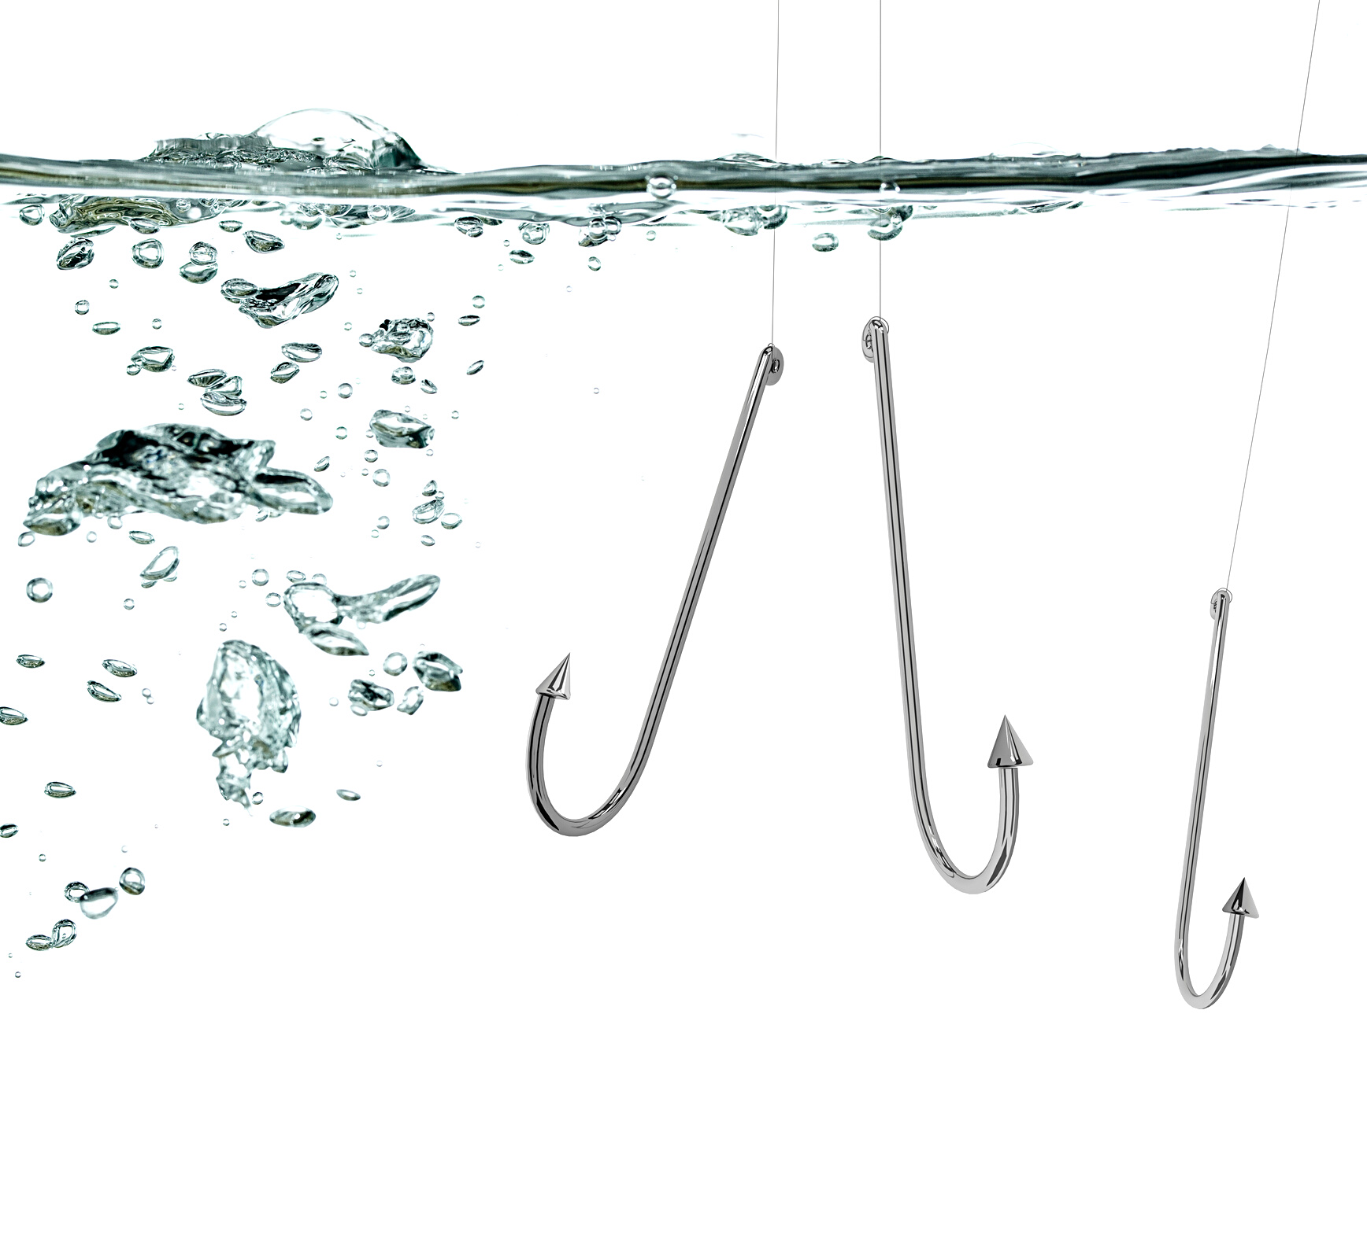
Part 4: The Hook
You want to establish a relationship with this person: what is your hook to follow up

Slide 20

Part 4: The HOOK
“So I promised at the start I am not here to sell to you, but to learn from you.”
“I only want to know if you would be interested in seeing what we develop out of this when we have something ready?”
“Also, we are looking to interview people similar to you, could you introduce me to someone who is as experienced as you are or has something to offer in our quest?”

Slide 21

In Review
Part 1: The Welcome
Part 2: Positioning your Customer
Part 3: Ranking the Problem
Part 4: The Hook
The Interview Formula

Slide 22
Key characteristics:
The interviewee will do 90% of the talking
Use open-ended questions
Explore the why and motivations
You must be ready to hear something new and BE CHANGED BY IT.

Slide 23
What did you observe?
How might we improve the gift giving experience?
What did you learn from the interview experience?
Notes:
To define the concept more clearly: [read definition]
The word GET is highlighted here because this is the stage where we currently find ourselves in our relationship with our customer
We are simply trying to figure out how to establish new relationships with the customer segments we have chosen

